Slide 1

JAVA-OOPS CONCEPT
PROF. S. LAKSHMANAN,
DEPT. OF B. VOC. (SD & SA),
ST. JOSEPH'S COLLEGE.

Slide 2
OOPS CONCEPT:
OOP is defined as an approach that provides a way of modulating programs.
By creating partitioned memory area for both data & method that can be used as templates for creating copies of such modules on demand.
Class
Object
Data Encapsulation
Data Abstraction
Inheritance
Polymorphism
Dynamic binding
Message passing
1. Object - Instance of Class
2. Class - Blue print of Object
3. Encapsulation - Protecting our Data
4. Polymorphism - Different behaviors at different instances
5. Abstraction - Hiding our irrelevant Data
6. Inheritance - One property of object is acquiring to another property of object

Slide 3
Class
Class is a user defined data type.
It is a collection of object.
A group of object same behaviors.
Collection Member Variable and Member method
Syntax:
class <class name>
{
Member Variable //Physical Propriety of characteristic (int sno;)
Member Method //Behavior of characteristic (void get())
}
Example:
building , chair

Slide 4
Object
Object are basic real time entity in an object oriented.
Object is anything that really exist the world.
It is a instance of classes.
Also take up space in the memory
Object interact by sending message
Syntax:
classname <objectname>=new constructorname();
Example:
wood , blueprint, place person, bank a/c

Slide 5
Example Program for Class ad object
import java.lang.*;
import java.io.*;
class student
{
String name;
int roll_no;
int sub1,sub2;
int total;
float per;
void getdata() throws IOException
{
BufferedReader br = new BufferedReader(new InputStreamReader(System.in));
System.out.println ("Enter Name of Student");
name = br.readLine();
System.out.println ("Enter Roll No. of Student");
roll_no = Integer.parseInt(br.readLine());
System.out.println ("Enter marks out of 100 of 1st subject");
sub1 = Integer.parseInt(br.readLine());
System.out.println ("Enter marks out of 100 of 2nd subject");
sub2 = Integer.parseInt(br.readLine());
}
void calculate()
{
total=sub1+sub2;
per=(total*100)/200;
}
void show()
{
System.out.println ("Roll No. = "+roll_no);
System.out.println ("Name = "+name);
System.out.println ("Marks of 1st Subject = "+sub1);
System.out.println ("Marks of 2nd Subject = "+sub2);
System.out.println ("Total Marks = "+total);
System.out.println ("Percentage = "+per+"%");
}
}
class q2student
{
public static void main(String args[]) throws IOException
{
student s=new student();
s.getdata();
s.calculate();
s.show();
}
}

Slide 6
Data Encapsulation
The essential details of an object are to be hidden from the user.
An access is to be provide only to the essential details of an object.
Encapsulation is also called information hiding.
Wrapping up of data and method into a single unit(called class) is know as encapsulation
Feature of encapsulation
Data is not accessed by external function
It provides path between data and program this insulation of data from direct access by the program is called data hiding or information hiding
Bind together code & data it manipulates
Private: Access only with in a class, data member marked private
Public: Methods usually marked public, private variable through the public methods.
EXAMPLE : ATM (Any Time Money)

Slide 7
Example Program for Encapsulation
import java.util.*;
public class encapTest
{
private String Name;
Private int age;
public void accept()
{
Scanner sr=new Scanner(System.in);
System.out.println("Enter the Employee Name and Age"):
Name=sr.next();
age=sr.nextInt();
}
public void display()
{
System.out.println("Employee Details");
System.out.println("Employee Name="+Name);
System.out.println("Employee age="+age);
}
}
class mainclass
{
public static void main(String argds[])
{
encapTest t=new encapTest();
t.accept();
t.display();
}
}

Slide 8
Data Abstraction
Abstraction refers to the essential details of an object that clearly demarcates it from other object.
The concept of abstraction is implemented in object oriented programming by creating class.
Abstraction makes only the relevant details of an object visible.
The classes use the concept of data abstraction they are known as abstract data type(ADT).
Example:
The owner of a car should known how to a drive, he should know how to use the accelerator pedal to increase or decrease the speed of the car.
And break pedal to stop the car.
He need not know about other inner component of car, which makes the car to move and stop

Slide 9
Abstract Classes
The abstract classes and abstract methods are declared by using the abstract keyword.
cannot create object of an abstract class.
Even if one method in a class is abstract, that class itself should be declared as an abstract class.
It is mandatory to override abstract method in the derived class.

Slide 10
A Method without a definition is known as an abstract method
Example:
public abstract void My Method(parameter list);

Slide 11
Example Program for Abstract class and Method
import java.lang.*;
import java.io.*;
abstract class temp
{
public int a,b,c;
public void add() throws IOException
{
BufferedReader br = new BufferedReader(new InputStreamReader(System.in));
System.out.println ("Enter a,b value");
a = Integer.parseInt(br.readLine());
b = Integer.parseInt(br.readLine());
System.out.println ("a+b="+(a+b));
}
abstract public int mul(int x,int y) throws IOException ;
}
class der extends temp
{
public int mul(int x,int y) throws IOException
{
int x1=x*y;
return x1;
} }
class eabs
{
public static void main(String args[]) throws IOException
{
int x,y;
der d=new der();
d.add();
BufferedReader br = new BufferedReader(new InputStreamReader(System.in));
System.out.println ("Enter x,y value");
x= Integer.parseInt(br.readLine());
y = Integer.parseInt(br.readLine());
System.out.println ("x*y="+ d.mul(x,y));
}
}

Slide 12
Inheritance
Creating a new class from existing class is called as inheritance.
It is avoid scalable in code.
Enable easy maintained of code.
Process of creating a new class by adding some feature to an exiting class.
Main advantage of inheritance is reusability of the code.

Slide 13
Types of Inheritance
Single Inheritance
Multiple Inheritance
Multi Level Inheritance
Hierarchical Inheritance
Hybrid Inheritance

Slide 14
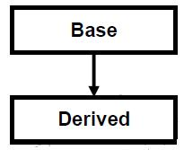
Single Inheritance
a single derived class is created from a single base class then the inheritance is called as single inheritance.
Syntax of Inheritance
class ParentClass
{ ...parent class code }
class ChildClass extends ParentClass
{ ...child class code }
Special Character " extends " in Inheritance
Inheritance uses special character called " extends " to make a relationship between parent and child class

Slide 15
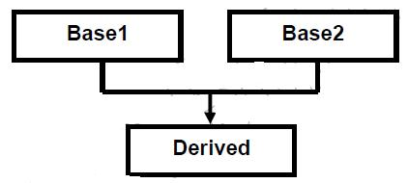
Multiple Inheritance
a derived class is created from more than one base class then that inheritance is called as multiple inheritance. But multiple inheritance is not supported by .net using classes and can be done using interfaces.
Syntax for multiple inheritance
class Parent
{
body
}
class parent2
{
body
}
class child : parent,parent2

Slide 16
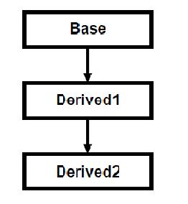
Multi Level Inheritance
a derived class is created from another derived class, then that inheritance is called as multi level inheritance.
Syntax for multi level inheritance
class parent
{
body
}
class child extends parent
{
body
}
class subchild extends child
{
body
}

Slide 17
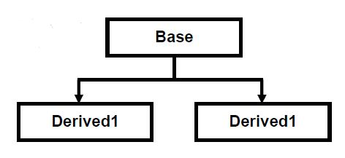
Hierarchical Inheritance
more than one derived class are created from a single base class, then that inheritance is called as hierarchical inheritance.
Syntax for C# hierarchical inheritance:
class parent
{
body
}
class child1 extends parent
{
body
}
class child2 extends parent
{
body
}

Slide 18
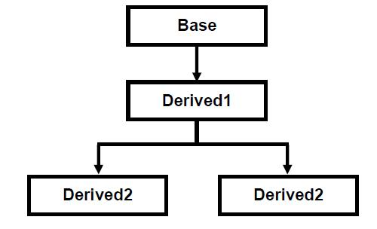
Hybrid Inheritance
Any combination of single, hierarchical and multi level inheritances is called as hybrid inheritance.

Slide 19
Polymorphism
Polymorphism allows routines to use variables of different types at different times.
Poly a Greek term ability to take more than one form.
An operator and function can be given different meanings and functionality.
Polymorphism refers to a single function or multi-functioning operator performing in different ways.
Polymorphism means having more than one form.
Two types
1.Compile time polymorphism or early binding or static binding .
2.Runtime polymorphism or late binding or dynamic binding.

Slide 20
Compile time polymorphism
Compile time polymorphism is method and operators overloading. It is also called early binding.
In method overloading method performs the different task at the different input parameters.
In Operator overloading single operator perform
different task at the different input parameters.

Slide 21
Runtime polymorphism
Runtime time polymorphism is done using inheritance and virtual functions.
Method overriding is called runtime polymorphism. It is also called late binding.

Slide 22
Dynamic binding
Binding :
refers to the linking of a produce call to the code to be executed in response to the call.
Dynamic Binding:
Dynamic binding(dispatch) means that a block of code executed with reference to a procedure(method) call is determined at run time.
It means that the code to be executed for a specific procedure call is not known until run-time.
Dynamic binding is also known as late binding or run-time binding.
Dynamic binding is an object oriented programming concept and it is related with polymorphism and inheritance.

Slide 23
Message Passing
Objects can communicate with each others by passing message same as people passing message with each other.
Decompose a problem into a number of object.
Objects can send or receive message or information.
Message passing involves name of object, name of function (message) and information to be send.
For example, student. Mark(name). Here student is object, mark is message, name is information.
Object A Object B
Data
Data
Methods
Methods

Slide 24
Feature of OOPS
programs divided into object
Data is hidden & cannot be accessed by external methods.
New data & methods can be easily added.

Slide 25
Interface
An interface is a collection of various method without definition(abstract)
An interface looks like a class, but has no implementation.
The only thing it contains are declarations of events, indexers, methods and/or properties.
The reason interfaces only provide declarations is because they are inherited by classes and struts.
Syntax:
interface <interface name>
{
Return type method_name1(parameter_list);
Type final variableName=value;
}

Slide 26
Constructor
Constructor used to initialize the variable, object and function.
A constructor is invoked automatically when you create an instance of class.
Constructor name and class name are same.
Does not use void keyword.
Does not call explicitly.

Slide 27
Types
Default Constructor
Parameterized Constructor
Copy Constructor
Static Constructor
Private Constructor

Slide 28
1.Default Constructor
A constructor without any parameters is called as default constructor.
Drawback of default constructor is every instance of the class will be initialized to same values and it is not possible to initialize each instance of the class to different values.

Slide 29
2.Parameterized Constructor
A constructor with at least one parameter is called as parameterized constructor.
Advantage of parameterized constructor is you can initialize each instance of the class to different values.

Slide 30
3.Copy Constructor
A parameterized constructor that contains a parameter of same class type is called as copy constructor.
Main purpose of copy constructor is to initialize new instance to the values of an existing instance.

Slide 31
4.Static Constructor
Static constructor used to initialize the static variables of class.
Variables are created by using static keyword.

Slide 32
Array
Arrays works as collections of items, for instance strings. You can use them to gather items in a single group, and perform various operations on them, e.g. sorting
Arrays are declared much like variables, with a set of [] brackets after the data type, like this:
The index start from Zero

Slide 33
Single Dimensional Array
It is used to represent list
Syntax
type[] <arrayname>= new type[size];
type[] base type of array it determines the data type for each element the compress on array.
new is special operator that allocated memory
Example:
int[] a=new int[] {1,2,3,4,5};
We also declare & initialize in the same line

Slide 34
Two Dimensional Array
contain row & columns in which each element is uniquely specified by row & column coordinate
Syntax
type[,] <arrayname>= new type[row,column];
Example
int[,] a=new int[4,4] ;

Slide 35
Thank You.

